Slide 1


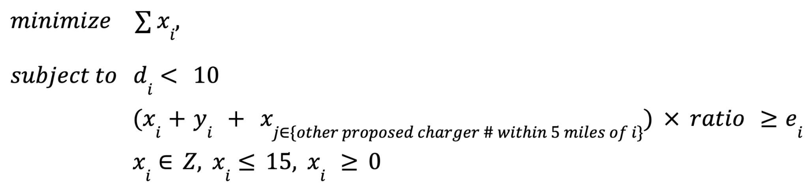
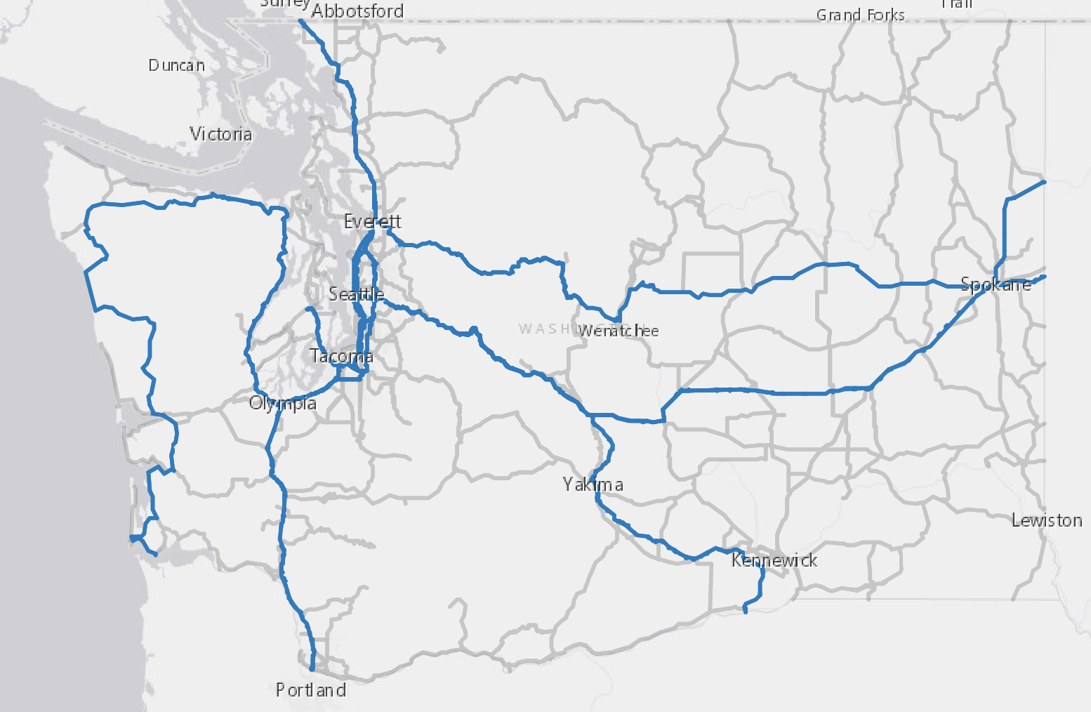
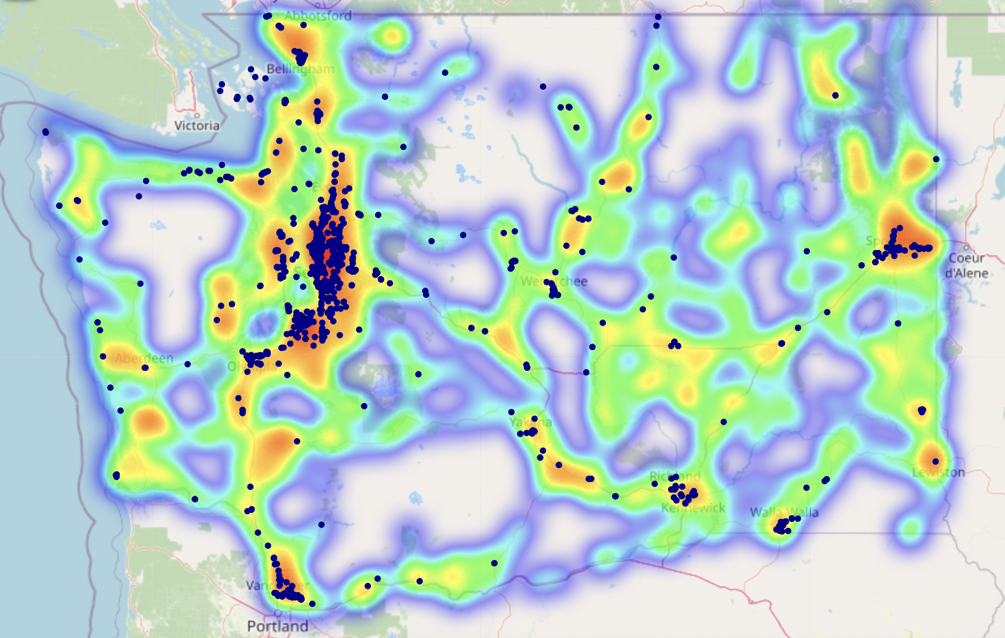
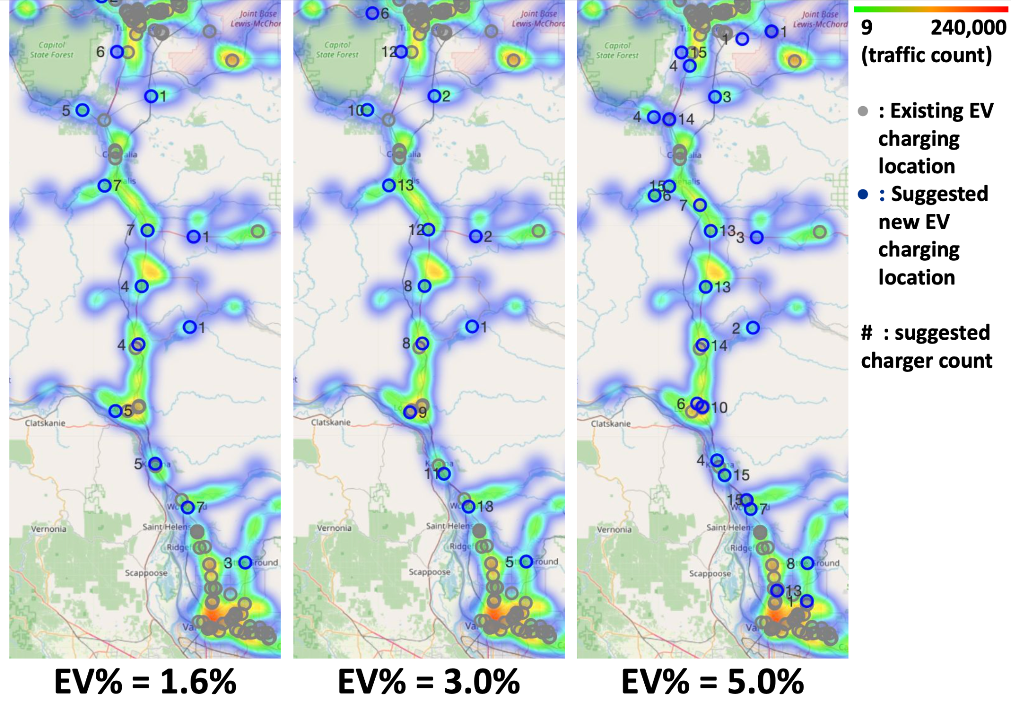
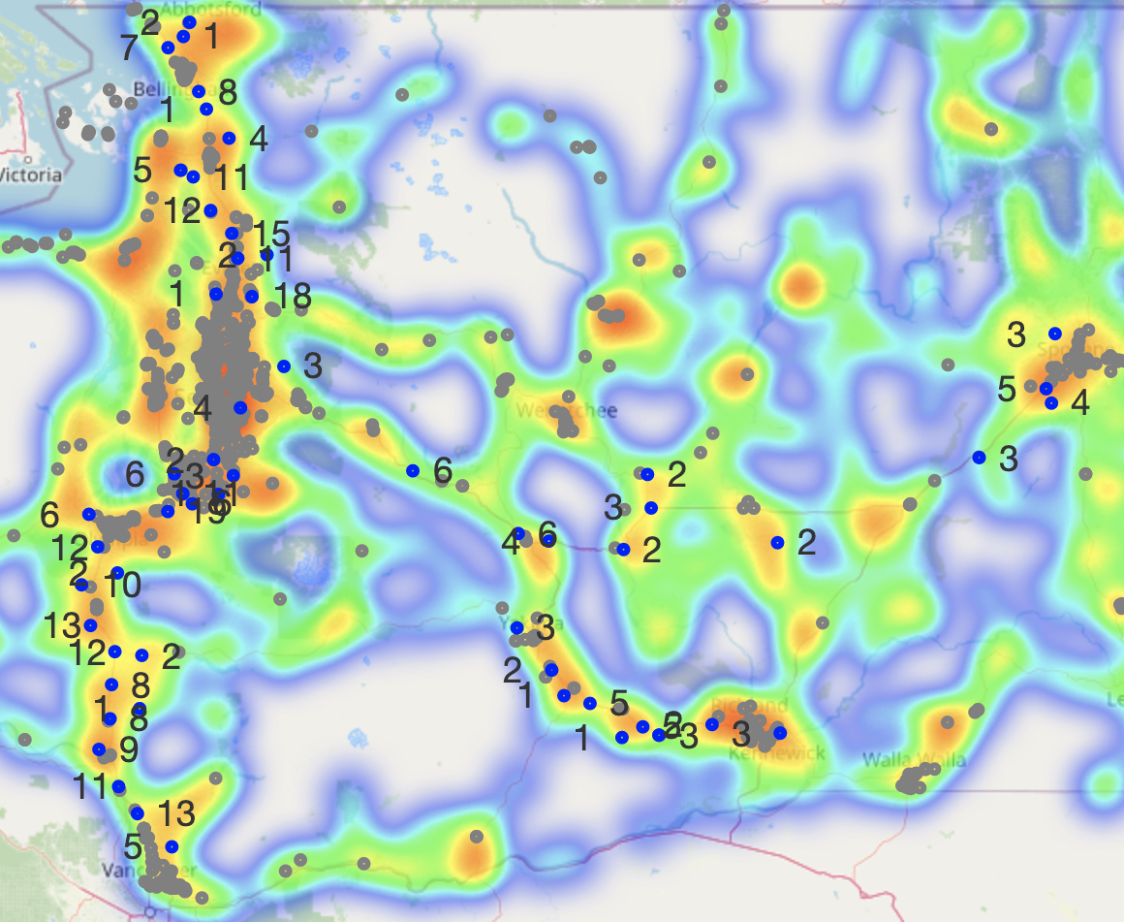
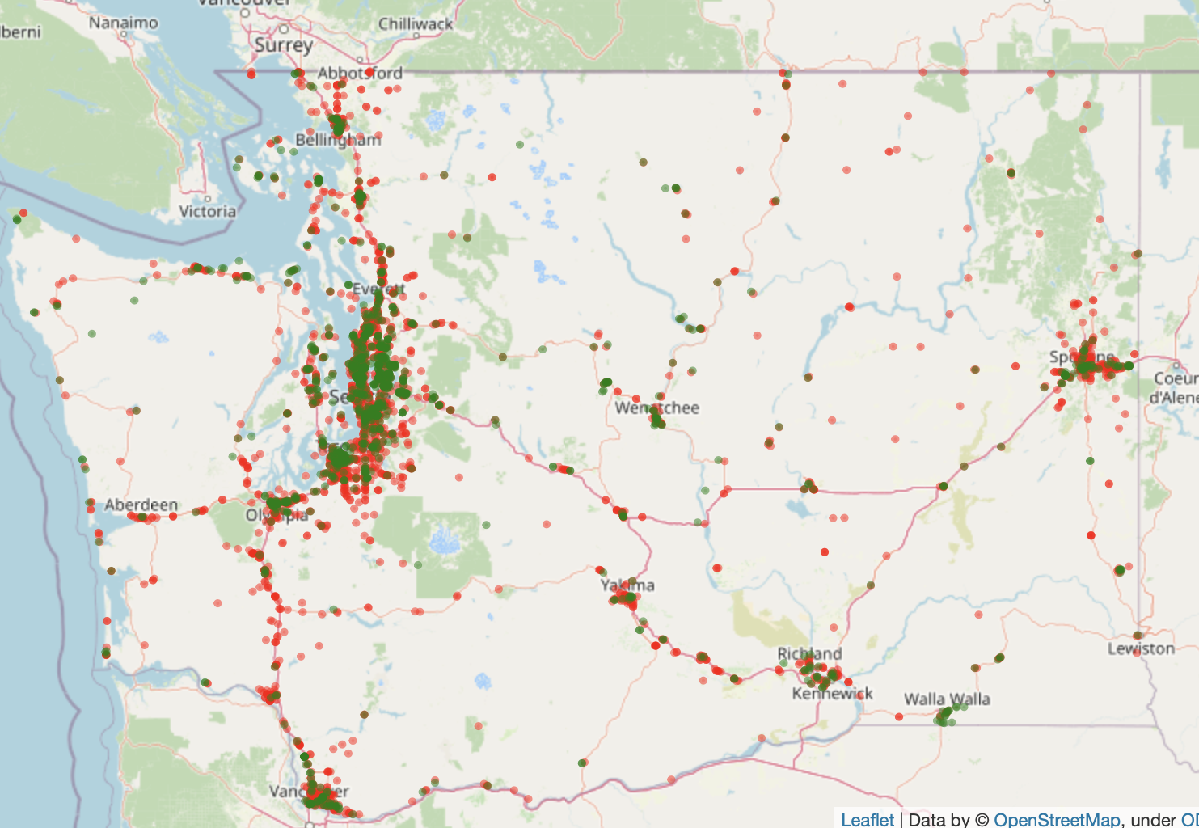
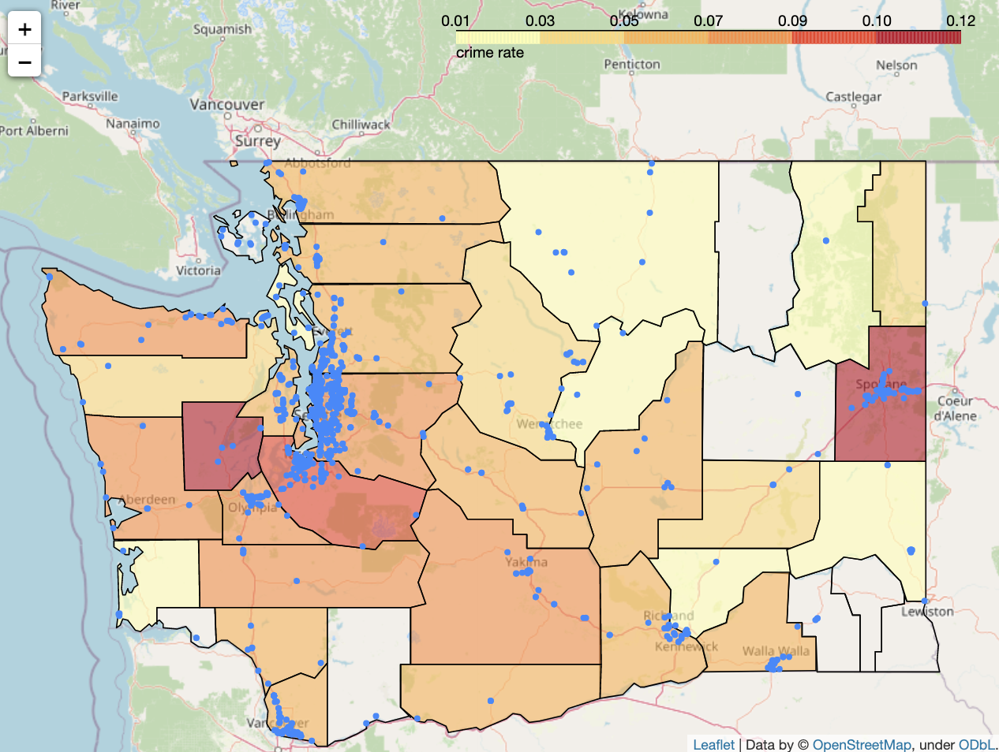
Optimized EV Charging Station Locations in Washington State
Anqi Lin, Clarissa Tai, Mengchen Xu, Yue Zhang, Yu-Chieh Chen
Industry Mentors: Alexander Voet, Arvind Sathi, Chengwei Wang, Jeffrey Lee, John Heath, Jordan Jalving, Michelle Zee, Sydney Son
Faculty Mentor: Adam Kelleher
Data Science Capstone Project
with
Project Background and Problem Definition
In November 2021, President Biden signed the bipartisan infrastructure bill, including a $5 billion investment in state-administered grants for nationwide EV charging stations. In this project, we tackle the challenge of how to best electrify our roads and communities to encourage balanced EV growth in communities. We integrated machine learning method together with optimization model to propose optimized number and locations of EV charging stations and chargers along major routes in Washington State.
Optimization Model
Our optimization model chooses candidates from existing gas station locations to put new EV charging stations, with the objective to minimize the total station and charger number while satisfying the following constraints:
The driving distance from highway exits to each locations should not exceed 10 miles
Newly added EV stations can support all EV traffics passing by
Charger count at each location should not exceed 15
For each location i, our variables are x (# of new chargers), d (driving distance from highway exits), y (existing EV charger # within 5 miles), e (maximum EV traffic within 5 miles). The model is:
Data Collection and Preprocessing
The data we collected included coordinates of daily traffic counters, gas stations, tourist attractions, current EV charging locations, highway exits, natural risk index of each census tract, and crime population of each city. Data was preprocessed by each gas location and generated new features such as distance to nearest attractions and highway exits. Based on the overall geographical distribution of the data points, the three circles in Fig 2. and Fig 3. indicated potential demand for EV charging stations. Hence, highway I-5, I-82, and I-90 were selected for advanced modeling.
Model Result
With different EV% of total registered vehicles scenario on example I-5 south area, model result is shown in Figure 3. The result on whole I-5, I-90 and I-84 are shown in Figure 4.
I-5
EV% = 3.0%
I-405
I-2
US 101
I-5
I-90
I-82
Figure 1. Important highways of WA state.
Figure 2. Daily traffic count(heatmap) with current EV charging stations(blue dots).
Figure 3. Optimization result on I-5 South
Figure 4. Optimization model result on whole I-5, I-90 and I-82
Conclusion & Looking Forward
Model-suggested new locations are evenly scattered around areas where higher traffic is presented. They not only fulfill the anticipated increasing demand in city area, but also fill the gap around comparatively rural areas. However, current optimization model doesn’t incorporate crime rate, NRI, attractions informations. For future steps, we can incorporate those factors to create a score on each optimized locations suggesting whether we recommend to build an EV station there.
References
Washington State Plan for Electric Vehicle Infrastructure Deployment, July 2022, https://wsdot.wa.gov/construction-planning/statewide-plans/washington-state-plan-electric-vehicle-infrastructure-deployment
Figure 3. Current gas stations (red dots) and EV charging stations (green dots).
Figure 4. Crime rate (total crimes/ population) with current EV stations(blue dots)

